Slide 1
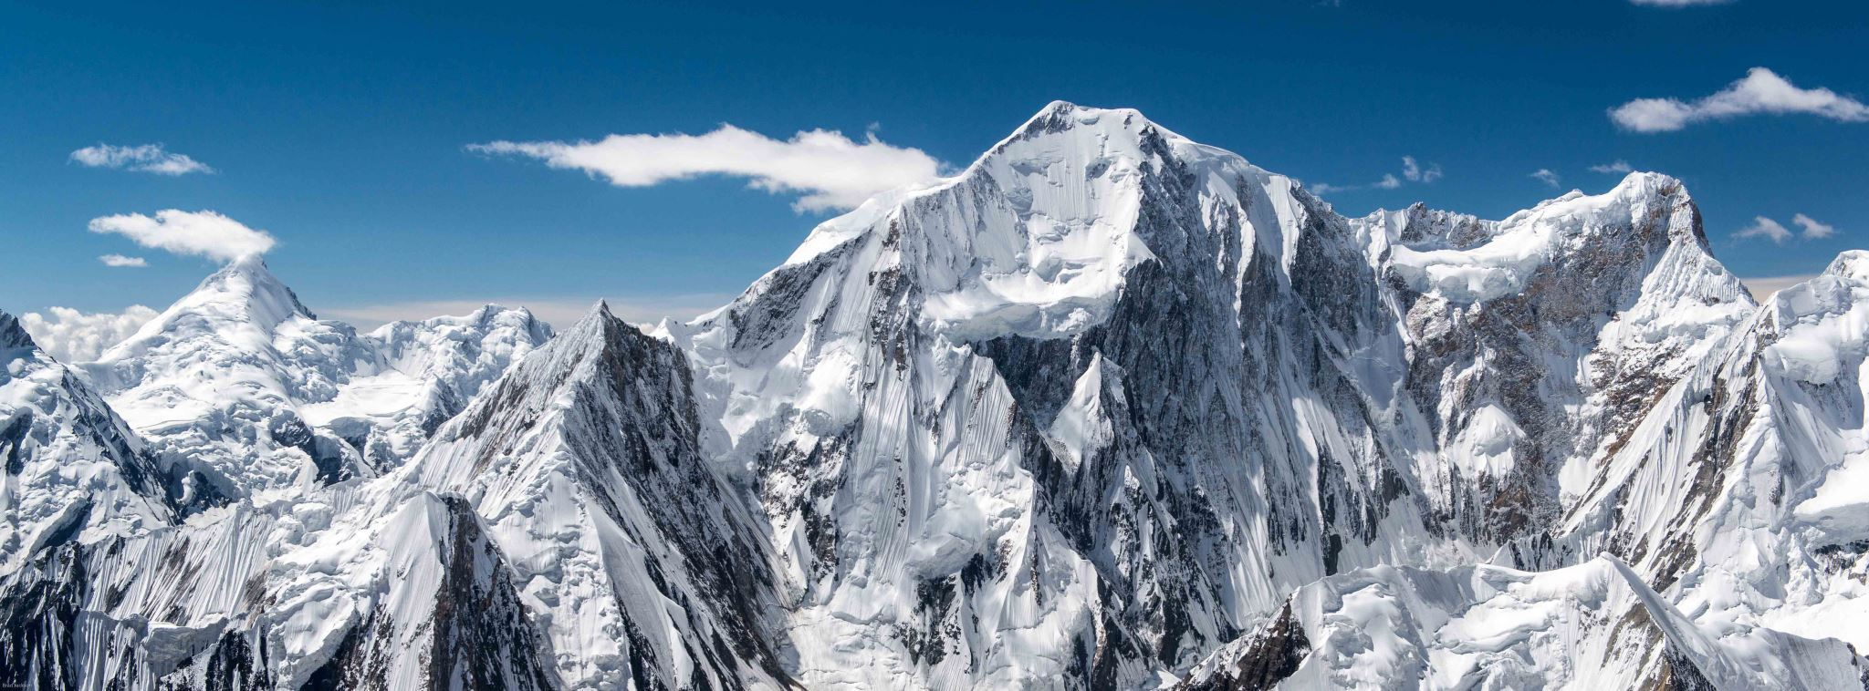
Mount Everest: The Roof of the World
Exploring the highest peak on Earth

Slide 2
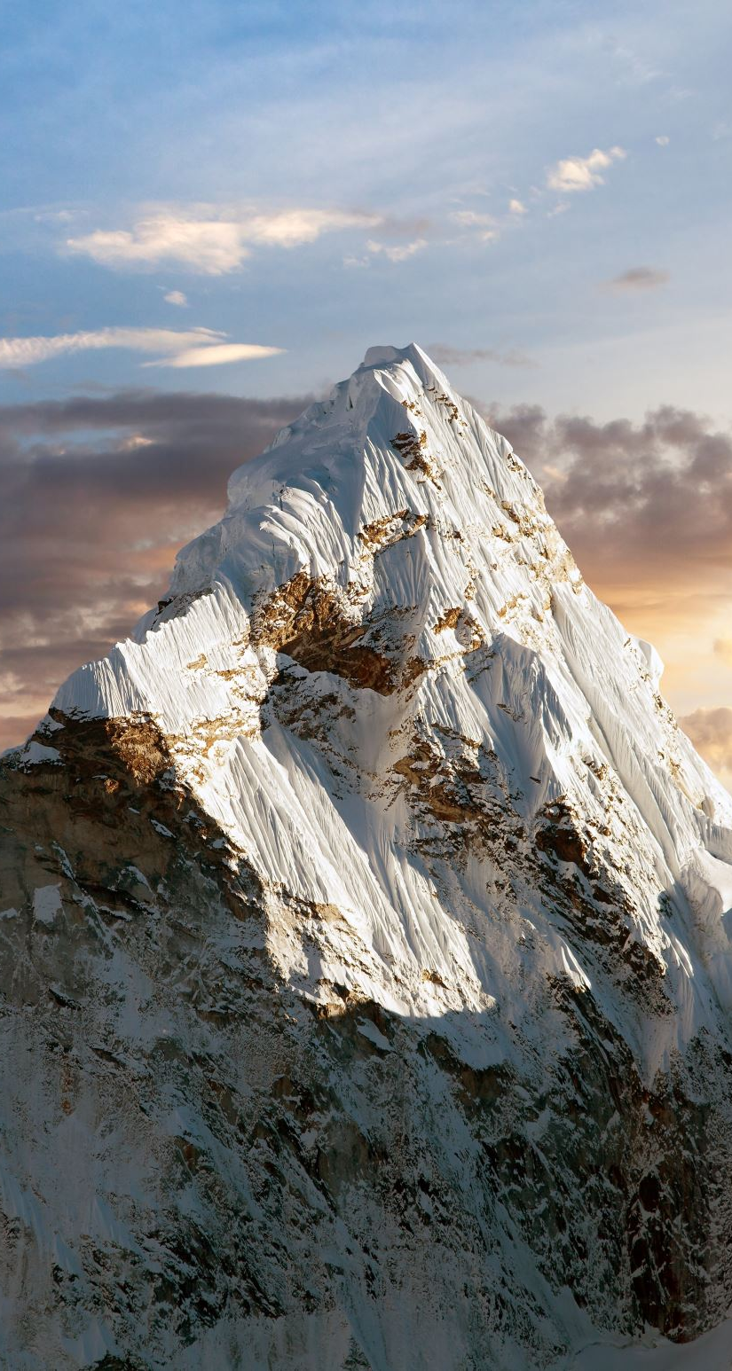
Introduction
Overview:Mount Everest, the highest mountain on Earth, stands at 8,848.86 meters (29,031.7 feet) above sea level.Known as “Sagarmatha” in Nepal and “Chomolungma” in Tibet, it is a symbol of human ambition and adventure.Significance:Attracts climbers from around the world, including seasoned mountaineers and novices.Represents the ultimate challenge in mountaineering and exploration.

Slide 3
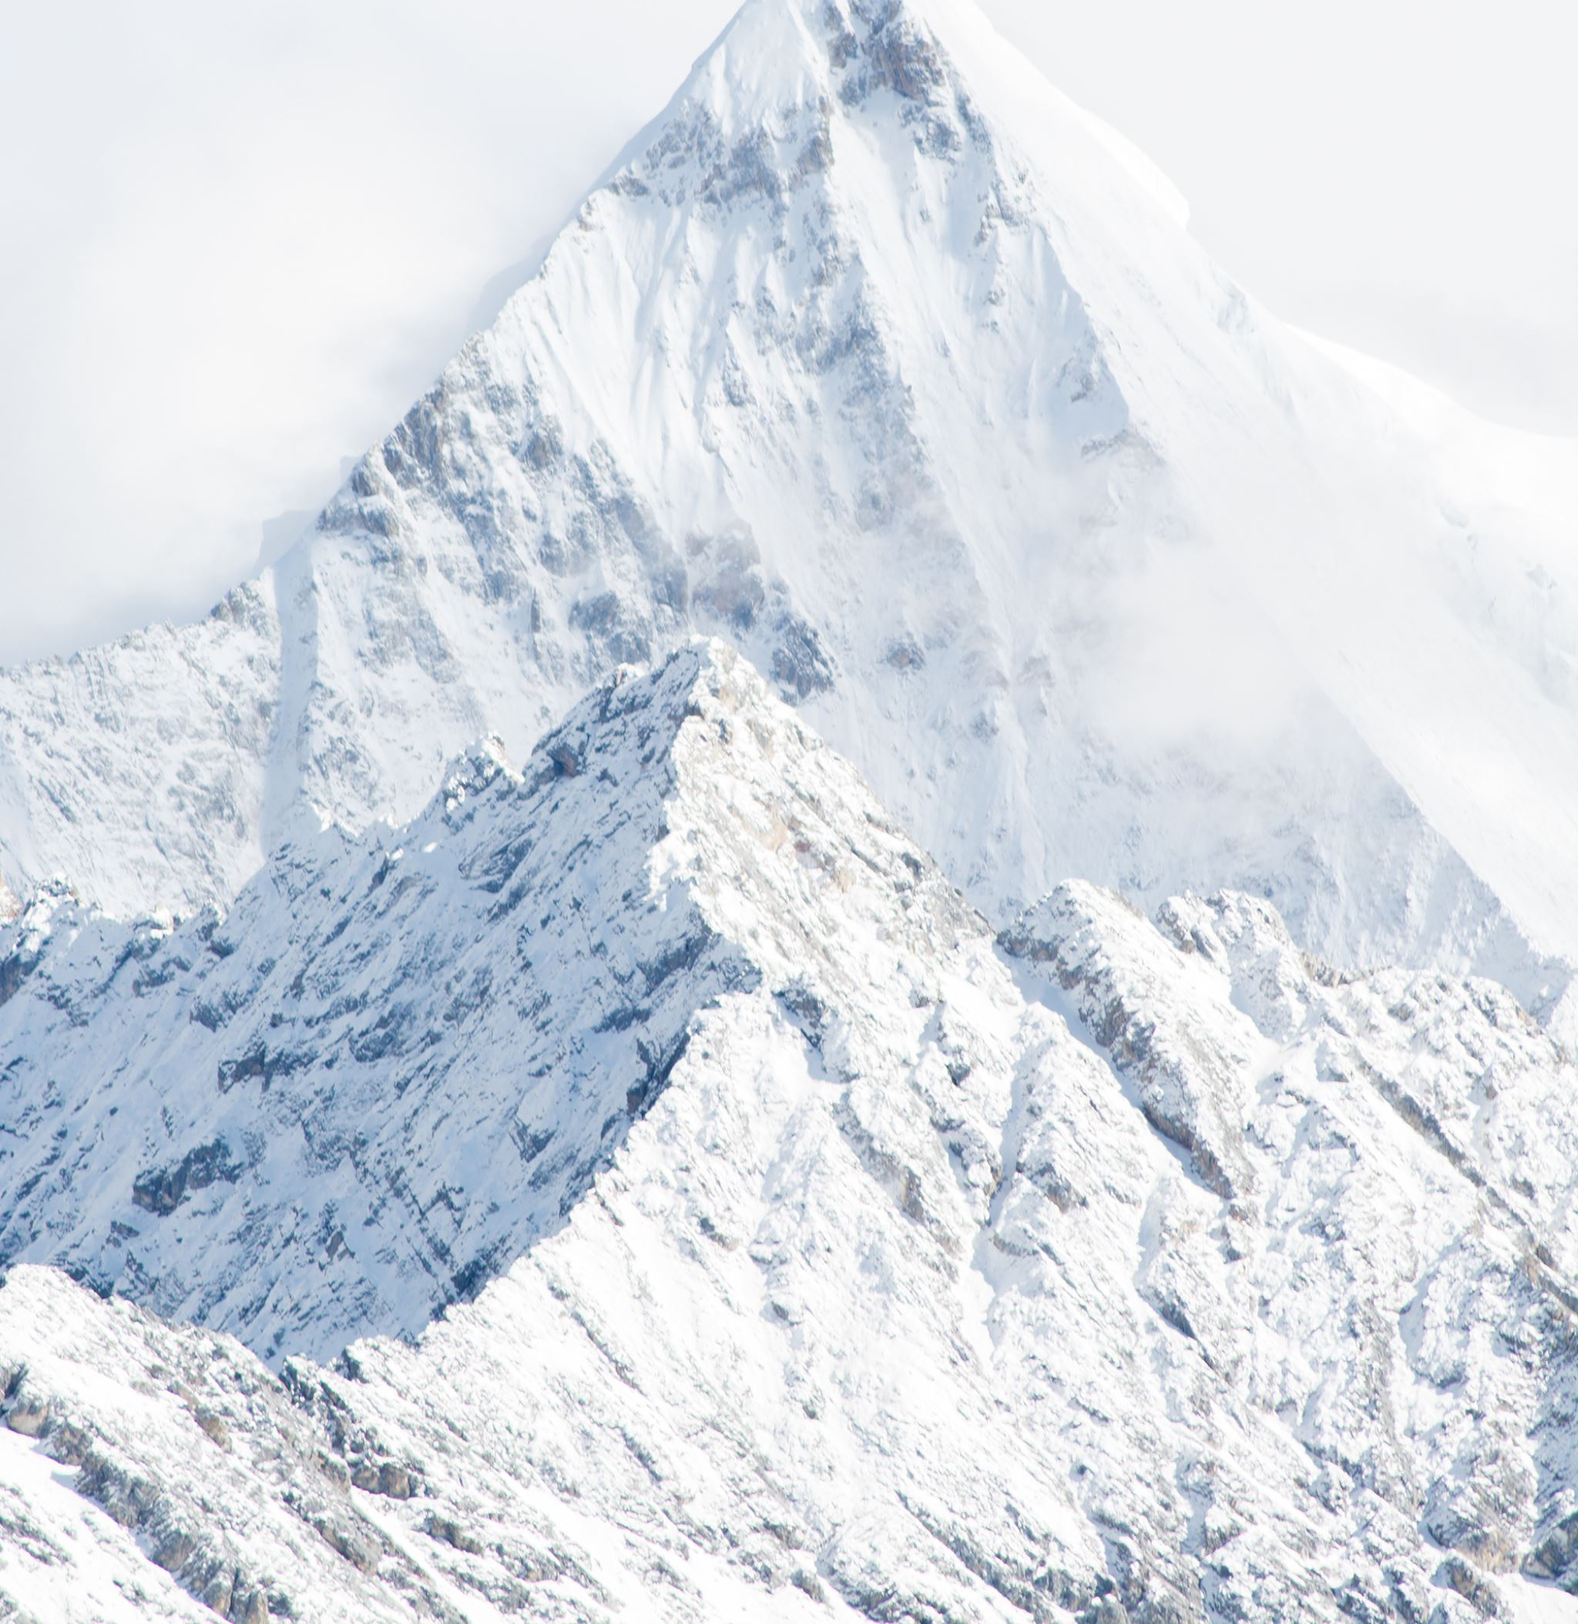
Geographic Location
Location:Mount Everest is situated in the Himalayas on the border between Nepal and the Tibet Autonomous Region of China.Coordinates:Latitude: 27.9881° NLongitude: 86.9250° ESurrounding Range:Part of the Mahalangur Himal sub-range, which includes several other notable peaks.

Slide 4
Physical Characteristics
8,848.86 meters (29,031.7 feet), recognized in 2020 after a joint survey by China and Nepal.Key Features:Khumbu Icefall: A treacherous section of the route, characterized by moving ice and crevasses.South Col: A critical camp area where climbers rest before their final ascent.Summit: Known for its harsh weather and thin air, making the final push to the top extremely challenging.

Slide 5
Historical Significance
First Successful Ascent:Achieved on May 29, 1953, by Sir Edmund Hillary from New Zealand and Tenzing Norgay, a Sherpa of Nepal.Impact on Climbing:This historic ascent opened the door for more climbers and made Everest a symbol of mountaineering.Modern Expeditions:Since then, thousands have summited, with climbing becoming a commercial enterprise attracting climbers globally.

Slide 6
Climbing Routes
South Col Route (Nepal):Most popular and frequently used route for climbers.Accessible through the Khumbu Valley; requires several camps to acclimatize.North Ridge Route (Tibet):Less traveled, presenting technical climbing challenges.Requires special permits from the Chinese government, making it logistically complicated.

Slide 7
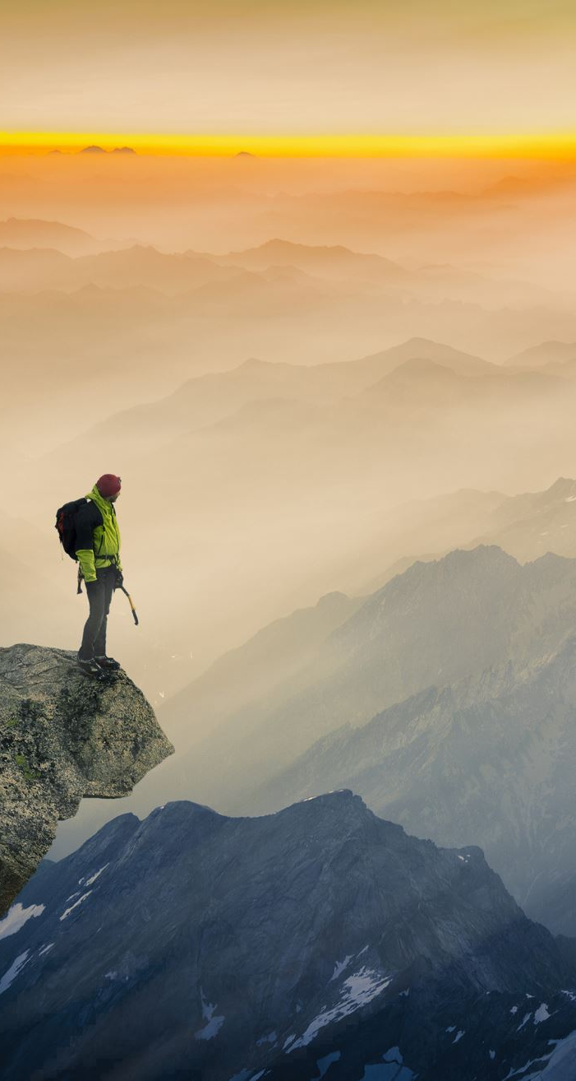
Challenges of Climbing
Extreme Weather:Sudden storms, high winds, and freezing temperatures can occur at any time.Altitude Sickness:Climbers experience reduced oxygen levels, which can lead to severe health issues like High Altitude Pulmonary Edema (HAPE) and High Altitude Cerebral Edema (HACE).Technical Skills Required:Climbers must be proficient in using equipment like crampons and ice axes, and possess high-altitude mountaineering skills.

Slide 8
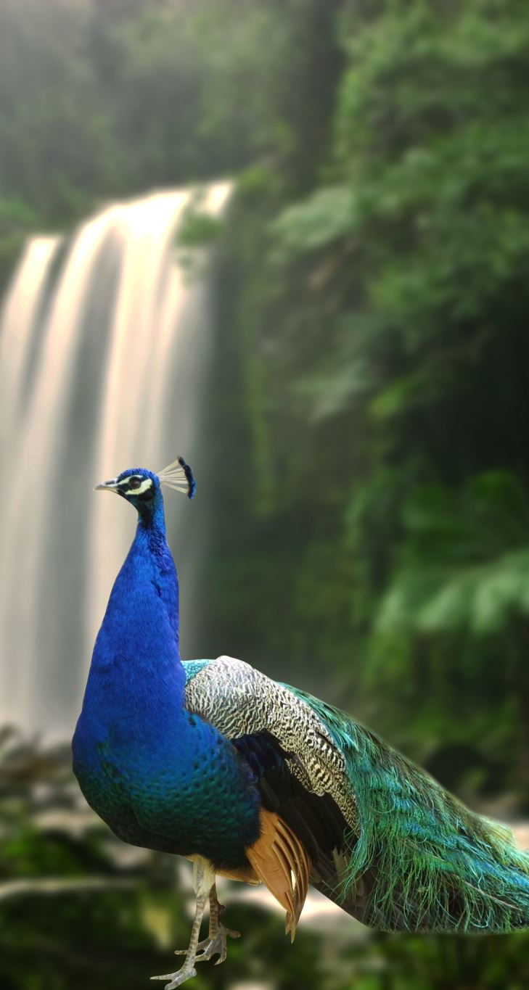
Flora and Fauna
Unique Ecosystems:Different elevations support diverse ecosystems, from lush forests at lower altitudes to barren landscapes near the summit.Common Species:Wildlife: Himalayan blue sheep, snow leopards, and various birds such as the pheasant.Flora: Notable plants include the rhododendron, which is the national flower of Nepal.Conservation Efforts:Initiatives aimed at preserving the unique biodiversity of the region due to threats from climate change and tourism.

Slide 9
Cultural Significance
Spiritual Importance:For local Sherpa communities, Mount Everest is sacred, viewed as a deity that protects them.Sherpa Traditions:Sherpas perform rituals for safe climbs, honoring the mountain and seeking blessings for climbers.Community Support:Strong sense of community exists among climbers and Sherpas, who work together to ensure safety and success.

Slide 10
Current Issues
Environmental Concerns:Increasing pollution and waste management problems due to the high volume of climbers, including discarded oxygen canisters and trash.Overcrowding:Popularity has led to bottlenecks on climbing routes, creating safety hazards and raising ethical concerns about the impact on the mountain.Climate Change:Rapidly changing weather patterns and melting glaciers affect climbing conditions and the surrounding ecosystems.

Slide 11
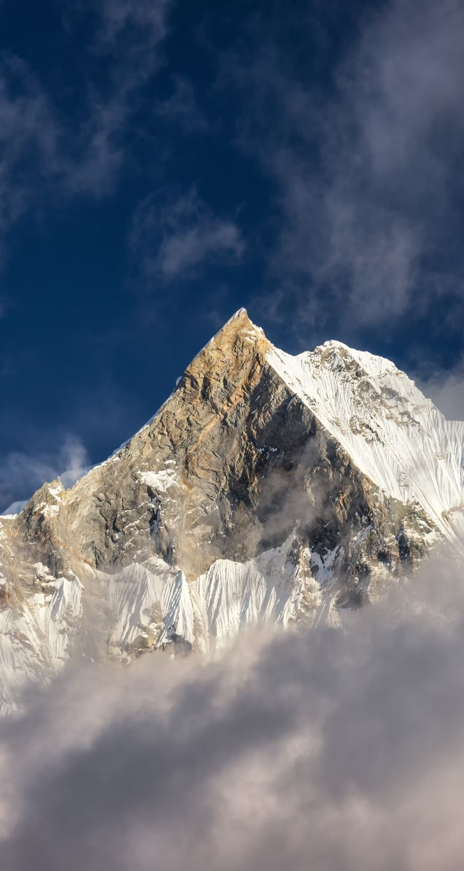
Conclusion
Symbol of Achievement:Mount Everest continues to represent human aspiration and the spirit of adventure.Need for Sustainability:Emphasizes the importance of sustainable climbing practices to preserve the mountain’s natural beauty and cultural significance.Final Thought:“The mountain is a challenge, a teacher, and a guardian of stories untold.”

